Slide 1
Unit 7 Probability

Slide 2
Advance organizer
Learning objectives:
Understand Combination and Permutation
Prior knowledge:
Understand 9.5 Geometric Series
Successful criteria:
Controlled Practice: Complete the Exit Card
Freer Practice: Complete questions to your interest
Learning activities:
1. Skim the text and examples (15 mins)
2. Understand the presentation (35 mins)
3. Complete the Exit card (25 mins)
4. Summaries the main idea and reflect (5 min)

Slide 3
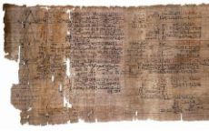
Key terms:
Permutation (排列方式): A way, especially one of several possible variations, in which a set or number of things can be ordered or arranged:
Combination (组合方式): Combination is a selection of items from a collection, such that (unlike permutations) the order of selection does not matter
Factorial (阶乘): The number of ways of placing n different objects in a line is n!
Rhind Papyrus: An ancient Egyptian scroll bearing mathematical tables and problems dates to 1650 BC.
MENSA: High IQ society, IQ ≧ 98% of the population

Slide 4
The Fundamental Counting Principle
If one event can occur in m ways and a second can occur in n ways, then the number of ways the two events can occur in sequences is m*n. This rule can be extended to any number of events occuring in sequence.

Slide 5


"My fruit salad is a combination of apples, grapes and bananas"
Combination (Order doesn't matter)
Peter, Mike and Jason will go watch a movie together.

Slide 6

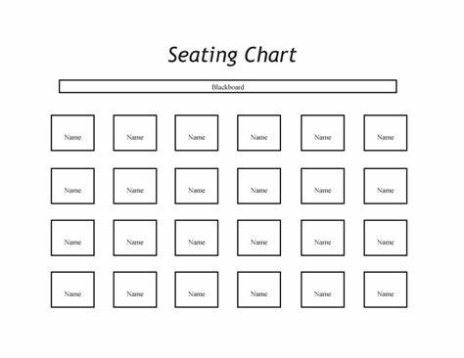
“The Access Code to the safe is 472”
Permutation (Order does matter)
“Seating Plan”

Slide 7

Practice: Crack the code
The access code for teacher's office consists of four digits. Each digit can be any number from 0 through 9.
How many access codes are possible when
1. each digit can be used only once and not repeated?
2. each digit can be repeated?
3. each digit can be repeated but the first digit cannot be 0 or 1?

Slide 8

Permutation
Repetition
(重复)
No Repetition
(不重复)
Code for a safe
99999
Seating Plan
Only one Jason

Slide 9
Factorials
5! = 5 x 4 x 3 x 2 x 1

Slide 10
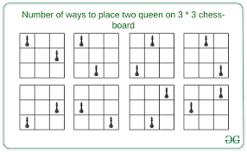
Number of ways placing n different objects
n!

Slide 11
Number of ways placing n different objects
Factorial: The number of ways of placing n different objects in a line is n!
How many ways can we do the seating plan for 11-5, assuming 26 students?
1 | 2 | 3 | 4 | 5 | 6
7 | 8 | 9 | 10 | 11 | 12
13 | 14 | 15 | 16 | 17 | 18
19 | 20 | 21 | 22 | 23 | 24
25 | 26

Slide 12
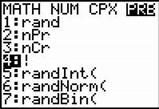
How many ways can we do the seating plan for 11-5, assuming 26 students?
1 | 2 | 3 | 4 | 5 | 6
7 | 8 | 9 | 10 | 11 | 12
13 | 14 | 15 | 16 | 17 | 18
19 | 20 | 21 | 22 | 23 | 24
25 | 26
26 x 25 x 24 x 23 ... x 1 = 26!
*TI -84
Go to Math --> PROB -->4

Slide 13
Example
Hint for (ii), think AE are together.

Slide 14

Greet

Slide 15
Example

Slide 16
Example

Slide 18
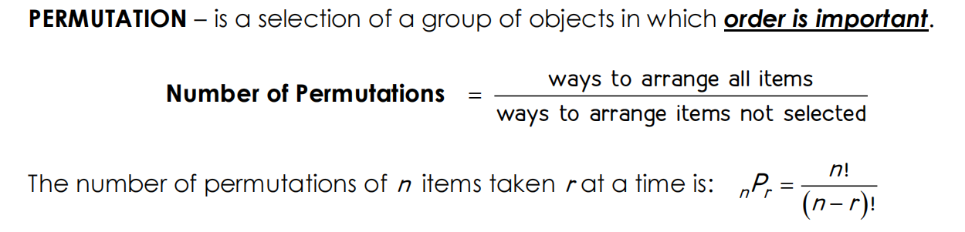
Permutation

Slide 19
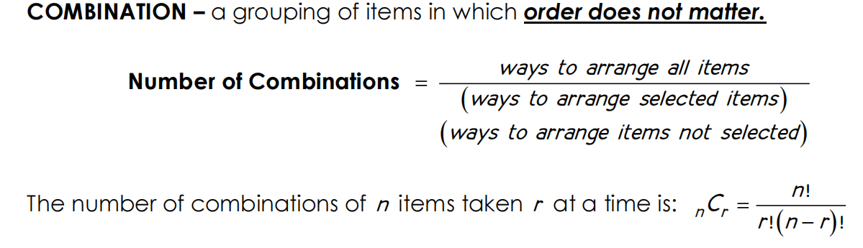
Combination

Slide 20
Exit Card:
Complete the permutation and combination learning sheet!

Slide 21
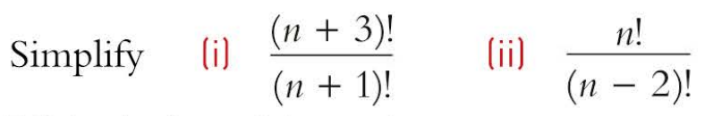
Warm up activity!

Slide 22
Advance organizer
Learning objectives:
Understand Theoretical and Experimental Probability
Prior knowledge:
Understand Combination and Permutation
Successful criteria:
Controlled Practice: Complete the Exit Card
Freer Practice: Complete questions to your interest
Learning activities:
1. Preview and Vocabulary Check (10 minutes): Quickly scan through the text and noting any unfamiliar terms.
2. Comprehend the Presentation (40 minutes):
3. Exit Card Completion (19 minutes):
4. Main Idea Summary and Reflection (1 minute):

Slide 23
Key terms:
Experiment [实验]: A scientific or systematic procedure conducted to make observations, test hypotheses, or gather data.
Outcome [结果]: The result or consequence of an experiment or event; what happens as a result of specific actions or circumstances.
Sample space [样本空间]: In probability theory, the set of all possible outcomes or events that can occur in a given experiment or random process.
Event [事件]: A specific outcome or subset of outcomes within a sample space; an occurrence or happening with a probability of its own within a larger context, such as an experiment or a random process.
Odds[赔率]: "Odds" refers to the probability or likelihood of an event happening or not happening, often expressed as a ratio or fraction. It can also refer to the difference in favorability between two or more choices, outcomes, or possibilities.

Slide 24
Experimental probability (实验概率)
Experiment: Roll a six-sided die
What is the sample space?
What is the outcome?
What are the possible events?
Roll an even number
Roll an odd number
Roll a one
Roll a two

Slide 25

Experimental probability (实验概率)
Experiment: Pick a card from a deck of cards
What is the sample space?
What is the outcome?
What are the possible events?
Get a card of 3
Get an even number
get a card less than 5

Slide 26
Theoratical probability (理论概率)

Slide 27
Example: What is the probability of rolling a 2 in a die
Sample Space:
Event:
Outcome(s):
Probability:

Slide 28
Example: What is the probability of roll an even number?
Sample Space:
Event:
Outcome(s):
Probability:

Slide 29
Discussion:
What is the probability of tossing a sum of 11 on the toss of two dice?

Slide 31
Practice:
What is the probability of getting a sum of 7 when two dice are tossed?

Slide 33
Probabilities of 0 and 1
0 Means impossible
0.2 or 20% means possible
0.5 or 50% means probable
0.8 or 80% means Highly probable
1 or 100% means certain

Slide 34
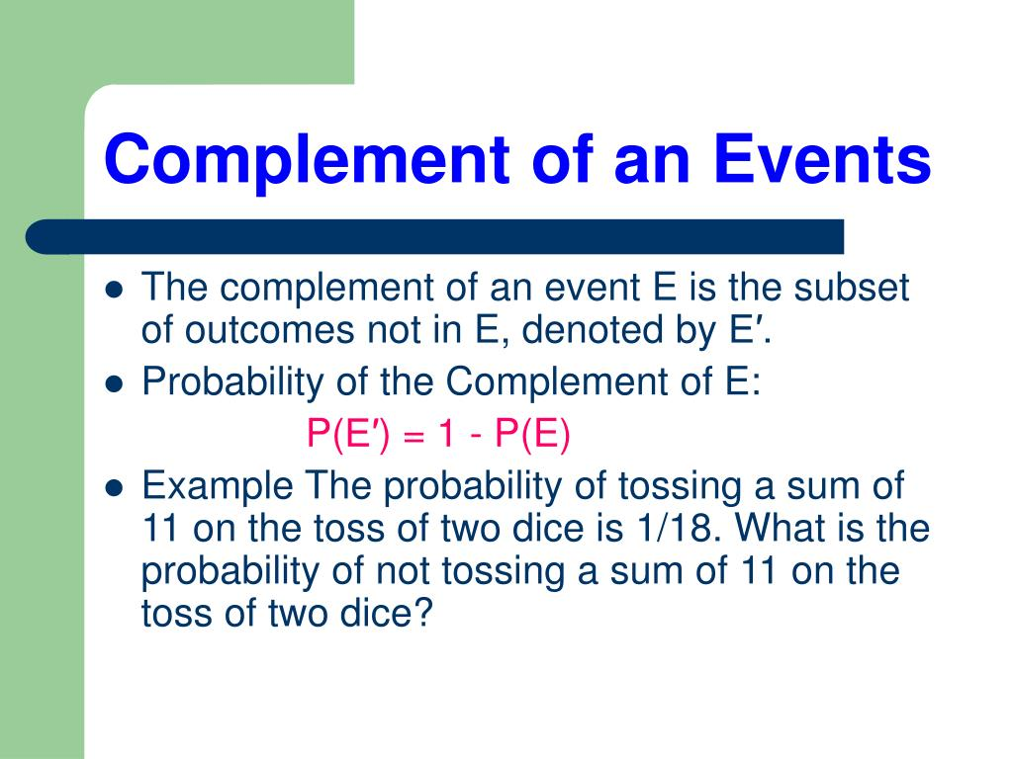

Slide 35
Exit Card:
Complete the “Theoretical and Experimental Probability” learning sheet!

Slide 36
Advance organizer
Learning objectives:
Understand Independent and Dependent Events
Prior knowledge:
Understand Theoretical and Experimental Probability
Successful criteria:
Controlled Practice: Complete the Exit Card
Freer Practice: Complete questions to your interest
Learning activities:
1. Preview and Vocabulary Check (10 minutes): Quickly scan through the text and noting any unfamiliar terms.
2. Comprehend the Presentation (40 minutes):
3. Exit Card Completion (19 minutes):
4. Main Idea Summary and Reflection (1 minute):

Slide 37
Key terms
Independent Events [独立事件]: Independent events are events whose outcomes do not affect each other. The occurrence or non-occurrence of one event does not change the probability of the other event occurring.
Dependent Events [依赖事件]: Dependent events are events where the outcome of one event affects the outcome of another. The occurrence of one event changes the probability of the other event occurring.
Exclusive [排外]: Not including; excepting.
Mutual [相互]: Held in common by two or more parties.
Mutually Exclusive [相互排斥]: Unable to be both true at the same time
Non Mutually Exclusive [相互不排斥]: Able to be both true at the same time

Slide 38
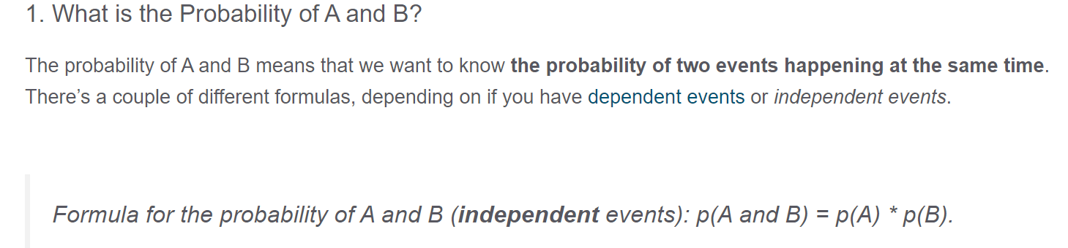
“AND” Event

Slide 39
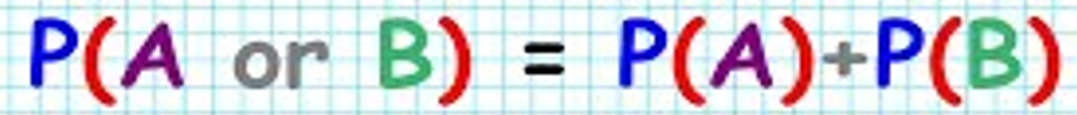
“OR” Event
We add probabilities together

Slide 40
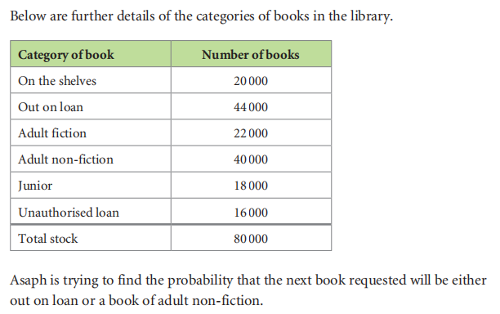
Example: Either “or” event

Slide 41
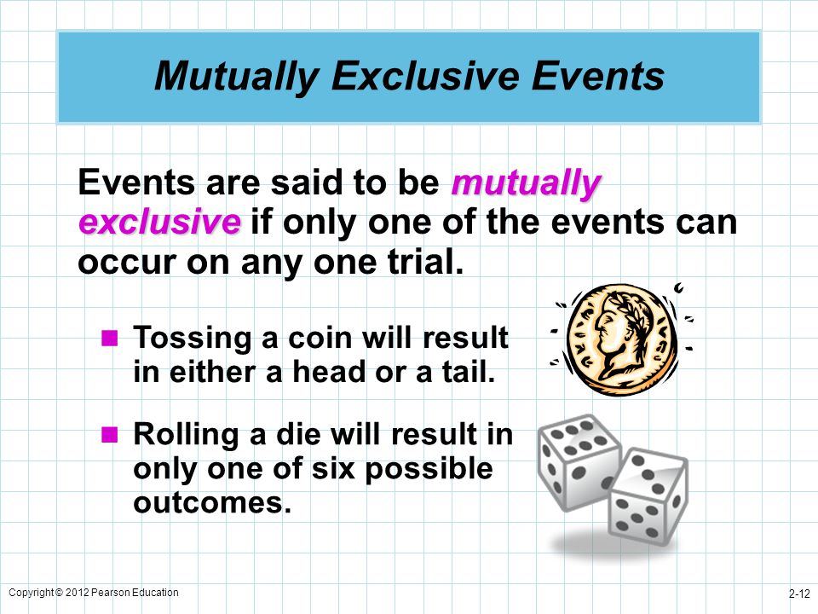

Slide 42
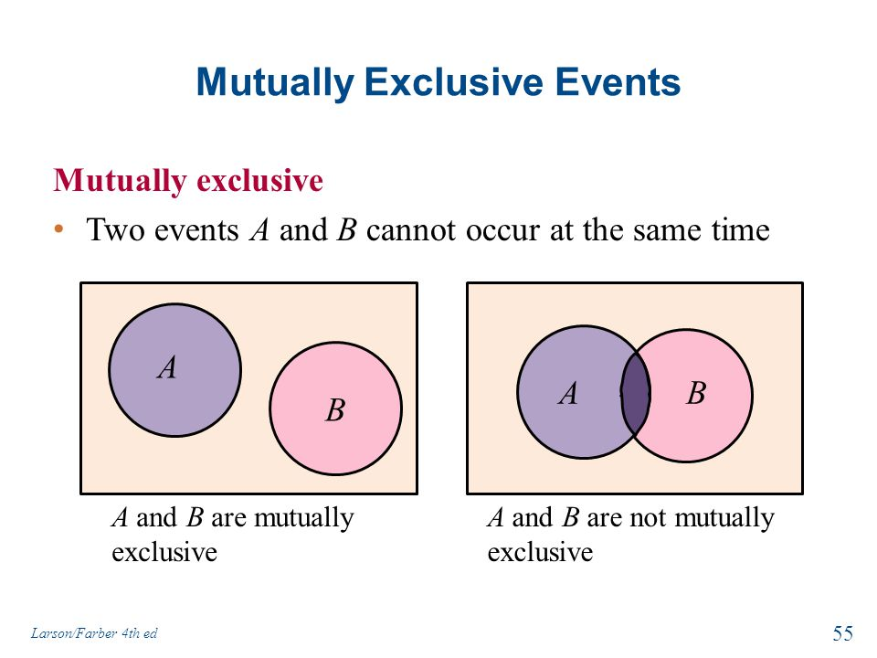

Slide 43
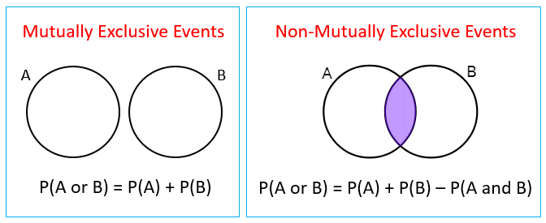
Calculate probability for non-mutually exclusive events

Slide 44
Example: Non-mutually exclusive events

Slide 45
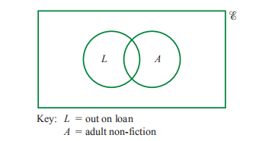
Non-Mutually exclusive events

Slide 46
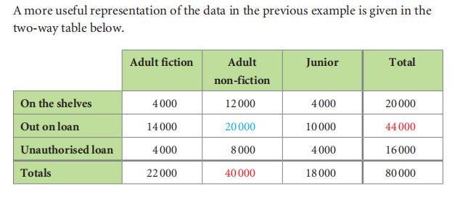

Slide 47
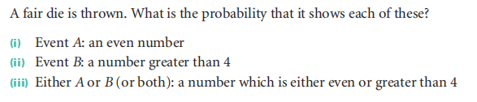
Example:

Slide 48
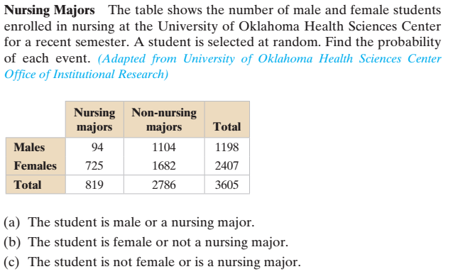
Mutually Exclusive Events

Slide 49
Answer
1. 0.533
2. 0.974
3. 0.533

Slide 50
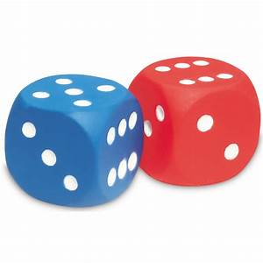
Practice:
With the throw of two dice, what is the probability that the sum will be a prime number? Hint: (2, 3, 5, 7, 11)

Slide 52
Exit Card
Complete the Independent and Dependent learning sheet!

Slide 53
Advance organizer
Learning objectives:
Understand Conditional Probability
Prior knowledge:
Understand Independent and Dependent Events
Successful criteria:
Controlled Practice: Complete the Exit Card
Freer Practice: Complete questions to your interest
Learning activities:
1. Preview and Vocabulary Check (10 minutes): Quickly scan through the text and noting any unfamiliar terms.
2. Comprehend the Presentation (40 minutes):
3. Exit Card Completion (19 minutes):
4. Main Idea Summary and Reflection (1 minute):

Slide 54
Key terms:
Conditional Probability[条件概率]: Conditional probability refers to the probability of an event occurring given that another event has already occurred.
Contingency table [列联表]: A contingency table, also known as a cross-tabulation or cross-tab, is a type of table in a matrix format that displays the frequency distribution of the variables.
Tree Diagram [树状图]: A tree diagram is a graphical representation used to display the outcomes of different decisions or events in a branching format.
P(B|A): The probability occuring of B given A happen first
P(A|B): The probability occuring of A given B happen first

Slide 55
Tree diagram

Slide 56
Tree Diagram - Toss a coin

Slide 58
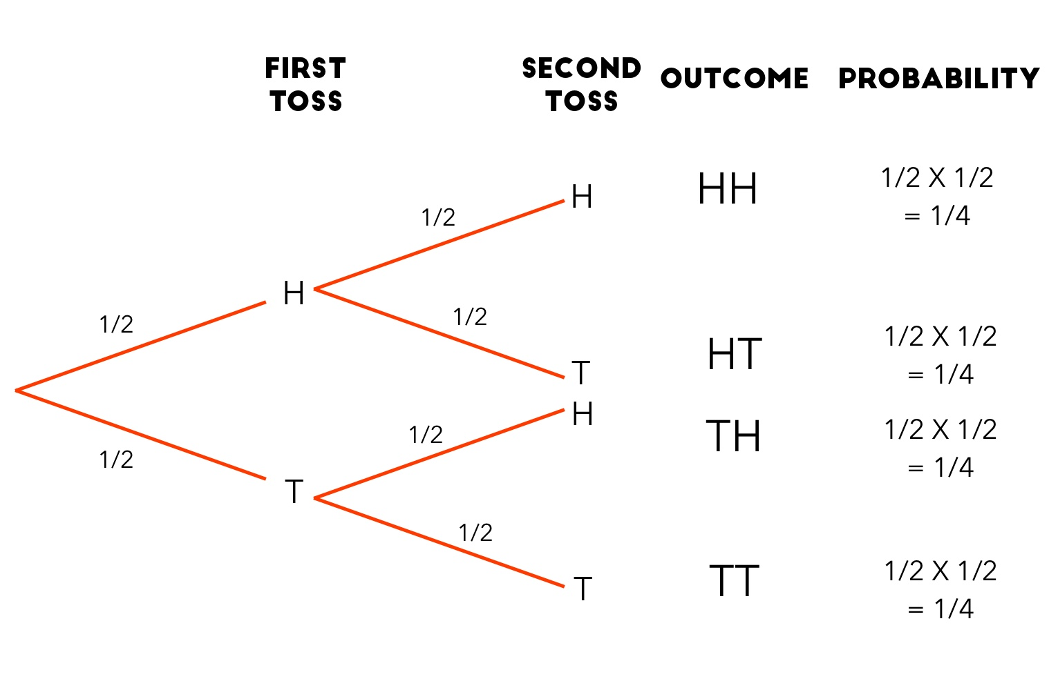
Tree Diagram - Common Format

Slide 59
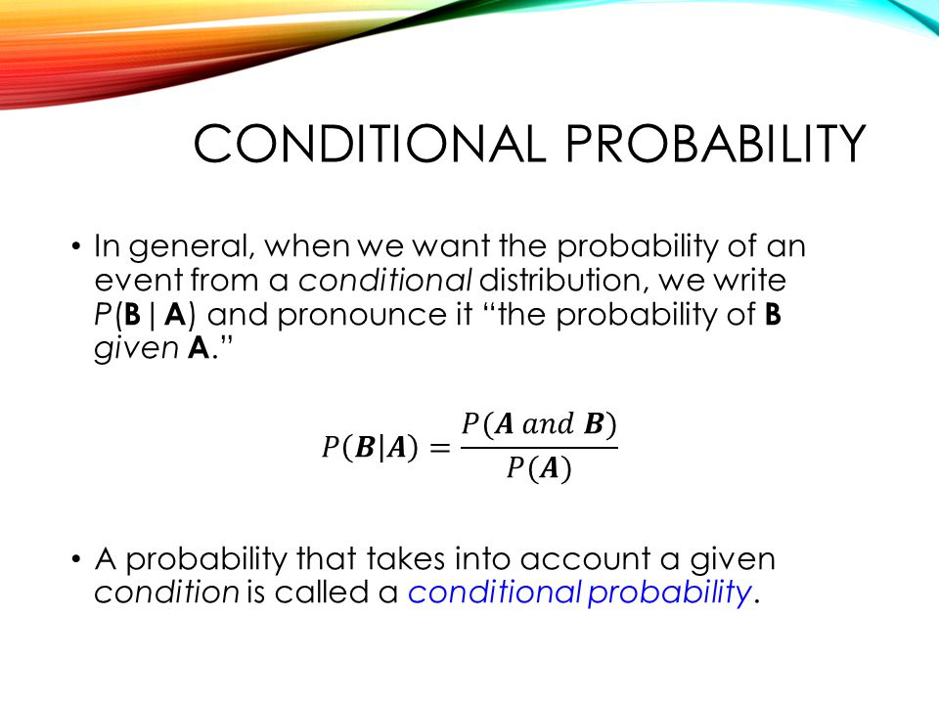

Slide 60
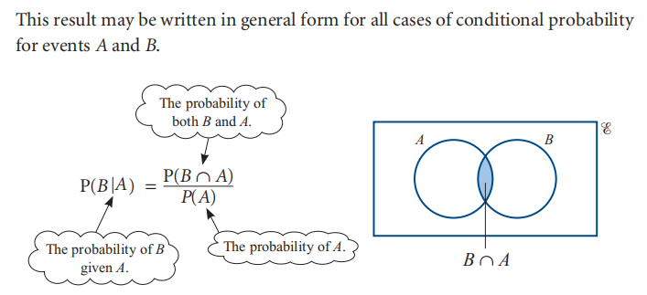
Conditional probability: Formula

Slide 61
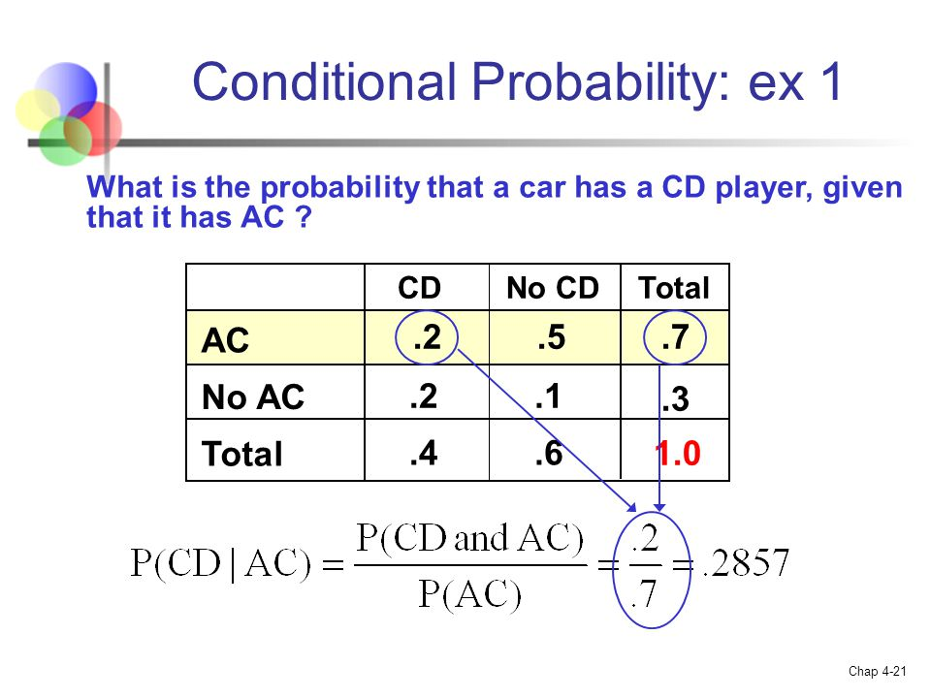

Slide 62
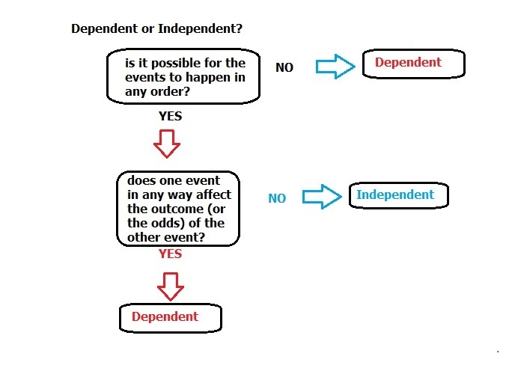

Slide 63
Independent vs. Dependent
 | Independent | Dependent
P(A) and P(B) | P(A⌒B) = P(A) x P(B) | P(A⌒B) = P(A) x P(B|A)
 | P(B|A) = P(B|A') | P(B|A) ≠ P(B|A')

Slide 64
Example

Slide 65
Example:

Slide 66
Exit Card:
Complete the Conditional Probability Learning Sheet!

